Slide 1
Multilevel Approach on Partitioning
Real World Graphs
Team 7
Yonwoo Choi, Sohyun Kim, Hyoyoung Lho

Slide 2

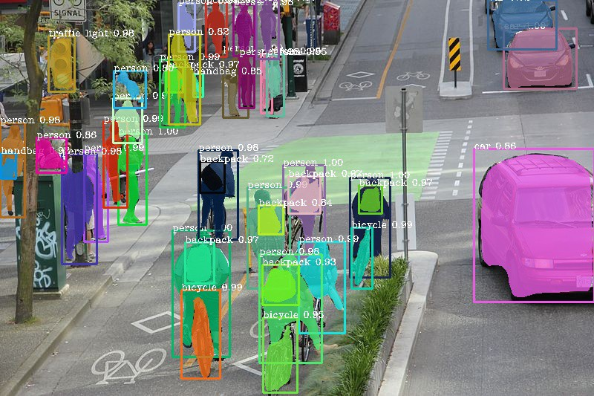
Introduction
Good partitioning of unstructured graphs needed for …
VLSI (Very Large-Scale Integration) Design
Reducing the connection between circuits in designing VLSI
Reducing number of connections among circuit components
Vision
Image segmentation
Similar pixels are represented as an edge
and more!
However, no general 'good cuts' on real world graphs!
VLSI
Image Segmentation

Slide 3
Problem Definition
Given a real world graph, how can we partition it fast and nicely?
For a graph G = (N,E),choose a partition N= N1 U N2 U …. NP such that: ∑(edge weights) of edges connecting all different pairs Nj and Nk is minimized.
Can be interpreted as “balancing the workload while minimizing communication”
Multi-level Approach used in general. Why? Real world graphs are too big to partition efficiently → replace the original graph by a coarse approximation (recursively if still big) before the actual partitioning

Slide 4
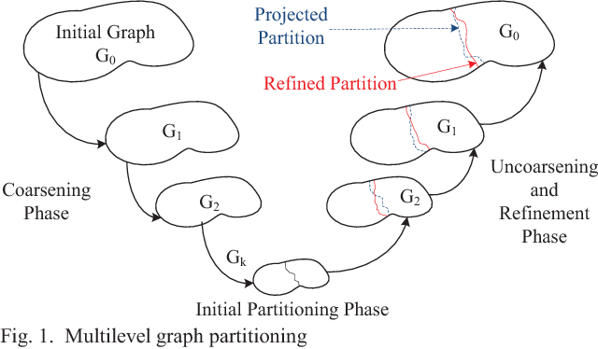
Multi-level Partitioning
1. Coarsening
Maximize matchings of vertices
Reduces number of vertices while preserving graph properties
2. Initial Partitioning
Randomized algorithms which pick the best partition out of a couple of runs
3. Uncoarsening (or Refinement)
Projecting back the partition to the original graph
Map the partition of a collapsed vertex to its constituent vertices during a projection

Slide 5
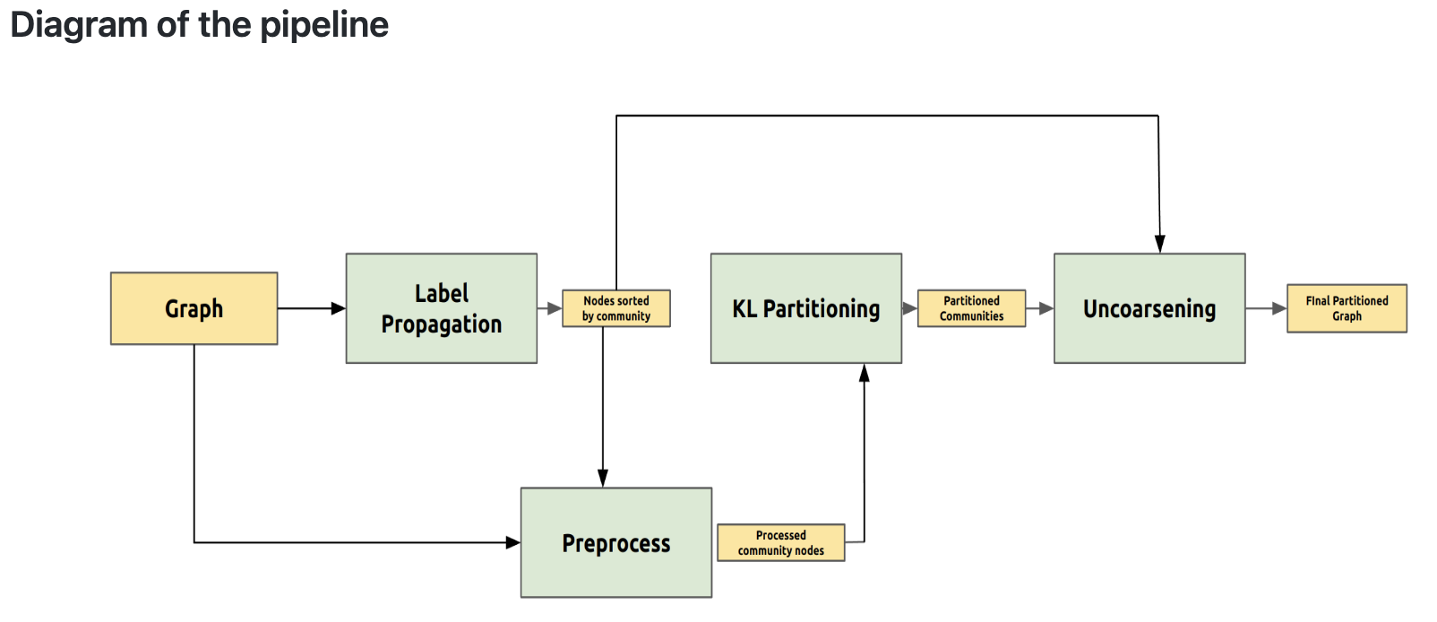
Method: Our Proposal
A Multi-level Approach
Coarsening: Use label propagation (community detection method)
Post-process the results made from step 1 to run the Kernighan-Lin (KL) algorithm
Partitioning & Refinement: Use a robust graph partitioning scheme (KL)
Uncoarsening: Recover original nodes from the partitioned clusters
Notes:
A Multi-level Approach
Coarsening: Use label propagation(community detection method) for the graph (reduce the size while maintaining important properties)
Partitioning: Use robust graph partitioning algorithm (Kernighan-Lin) to partition the graph more elaborately

Slide 6
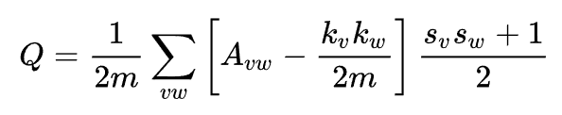
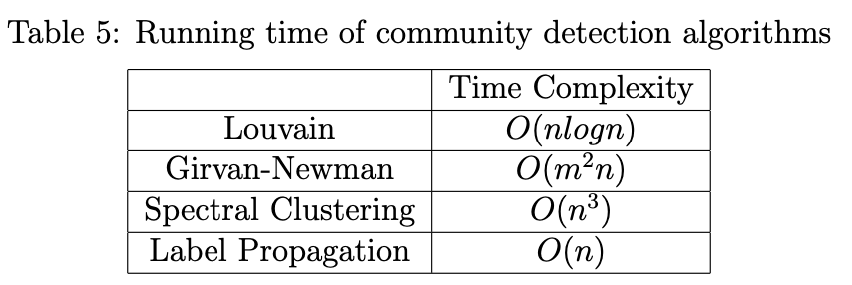
Method: Our Objective
Obtain high modularity : a graph is modular if there exists a highest density of edges inside a community and a low density of edges between different communities
Obtain minimized normalized cut (min-cut)
Minimize running time

Slide 7
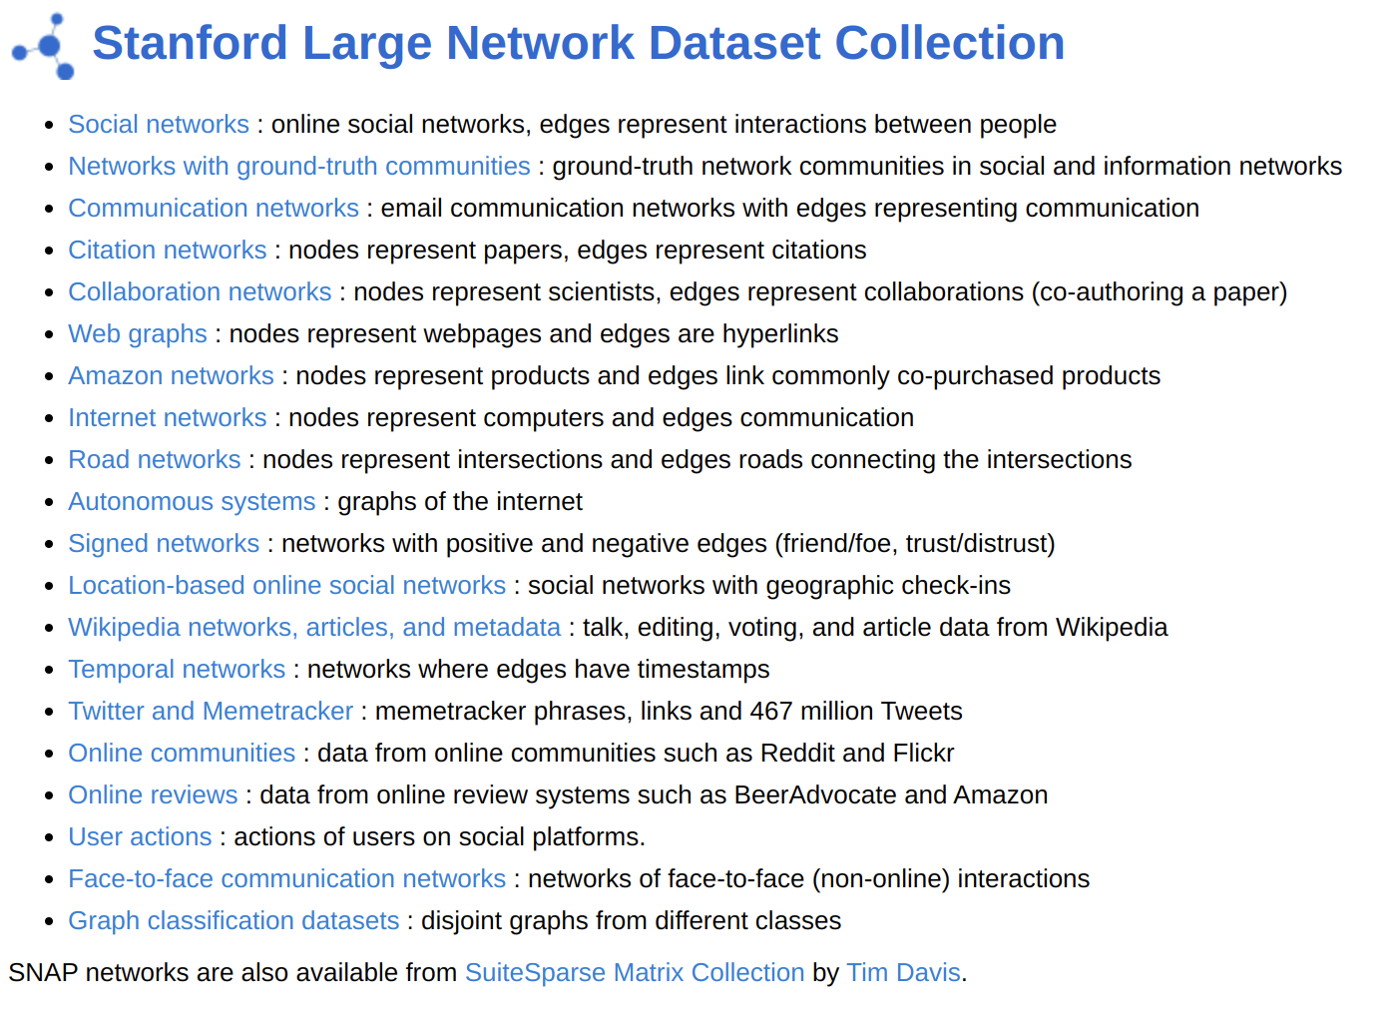

Experiments: Datasets
SNAP (Stanford Large Network Dataset Collection)
musae-github - Social network of Github Developers: |V|=37,700 |E|=289,003
ego_facebook - Social Circles from Facebook: |V|=50,515 |E|=819,306
ego_google - Social circles from Google: |V|=107,614 |E|=13,673,453

Slide 8
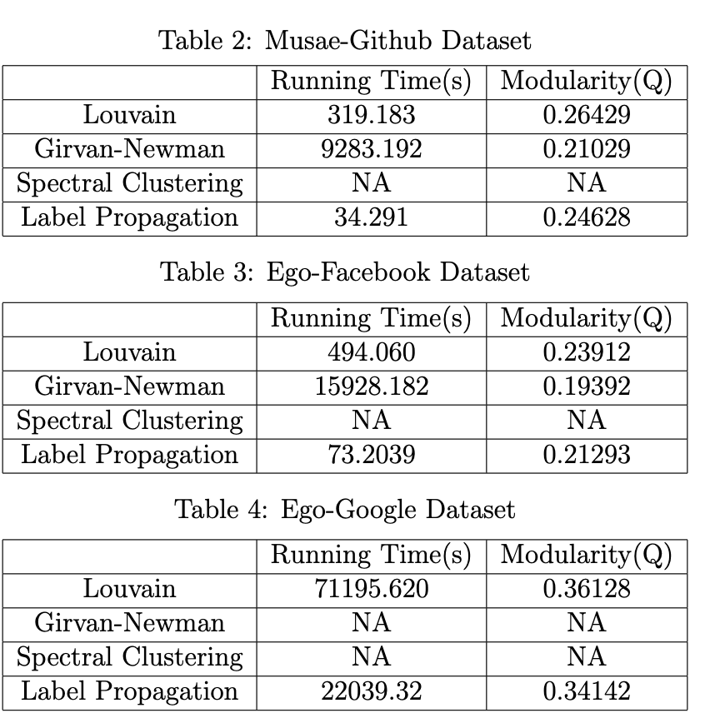
Experiments: Coarsening
Competitors: Louvain, Girvan-Newman, Spectral clustering, Label Propagation
Running Time: Large Decrease
Modularity: Slight Decrease

Slide 9
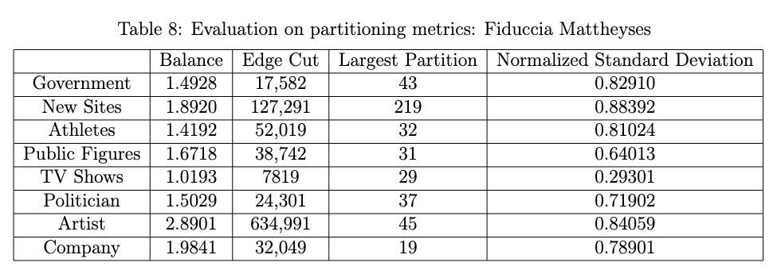
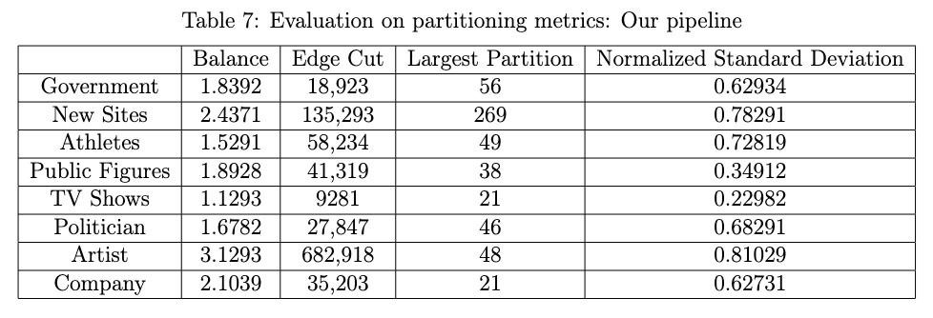
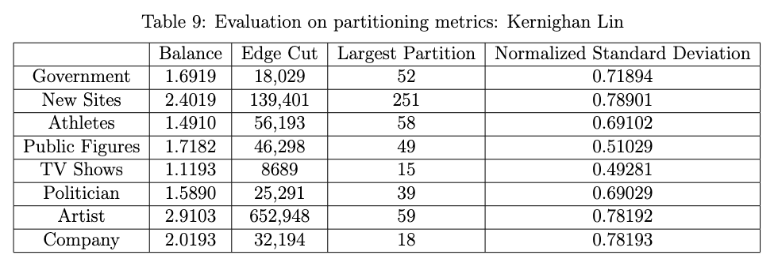
Experiments: Overall Pipeline (1)
Loss in partitioning quality

Slide 10
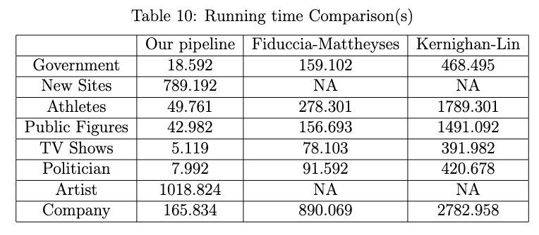
Experiments: Overall Pipeline (2)
Huge gain in running time

Slide 11
Conclusion
Multi-level Graph Partitioning, how can we partition real world graphs fast and nicely?
Applying label propagation algorithm in Coarsening Phase:
can reduce a big amount of run time
slight loss of modularity (little to almost none)
slight loss of partitioning quality (edge cuts)

Slide 12
Thank You

